Slide 1
Robotic Flag Finder
ECE 3333/3334-302
Instructor: William Ray
Group 6: Leader - Joseph
Adam Harper - Systems Engineer
Celina Luckevich - Image Process Engineer
Joseph Mahoney - Software Engineer
Joshua Warren - Comms. Engineer

Slide 2
System Description
Two robots are designed to search a room for flags, retrieve the flags, and return to their home base. The robots can work both cooperatively and competitively, each trying to find the most flags but ensuring all flags are found. They send video and location feed over a wifi network to a computer where instructions for driving the robots are derived from the video; these instructions are then sent back over the network to the robots. The system works autonomously, but a manual, human-controlled mode is also available.

Slide 3
Last Week Deliverables
Joe
Research creating a user interface and communicating with the CC3220 via wifi.
Look into displaying a video stream in a GUI
Josh
Begin simple image processing
Research into controlling the CC3220 through Wi-Fi.
Began streaming video over network.
Celina
Learn basic Python
Begin simple image processing and filtering codes
Adam
Research computer communication with IP Cameras
Testing camera communication

Slide 4
Safety Considerations
Avoiding short circuits, causing overheating.
Careful to operate robots at a safe speed to avoid damaging parts/people
Exercise caution to avoid cuts from sharp wire ends
Covering wires when cutting to keep ends from flying
Always use proper PPE

Slide 5
Division of Labor
Josh
Rover side
Computer Vision
Communication between Camera and OpenCV
Celina
Rover side
Computer Vision
Image Processing and Analysis
Flag finding/Detection
Adam
Computer side
Communication between robots and computer
Communication between camera and computer
Joe
Computer side
GUI
Robotic arm

Slide 6
Block Diagram
WIFI
Physical connection
Uart
Power
GPIO
PWM
Power
Robot #2 is identical
PC
sensors
Robot #1
Ultrasonic
HC-SR04
Wifi Camera
External rechargeable battery
CC3220
MCU
mechanical
3.3 V
5 V
3.3V
3.3 Volt
Regulator
5 V Voltage
Regulator
9.6v
9.6V
2000mAh
9.6 V
9 V Voltage
Regulator
3.3v
Data Computation
3.3v 50 Hz
Dagu - Rover 5 chassis motors
5 V Voltage
Regulator
HS-422
Survo
Uxcell 9V 50N
Electromagnet
Circuits
7.2 V
H-Bridge
Joe Mahoney

Slide 7
Development approach
Establish Internet Connection
Stream video and Pass data
Connect to a Master Code on a computer
Communicate with board on Rover
Recognize objects through camera
Isolate and center Flag
Build second Rover
Get rover moving
Add sensors and arm
Develop different modes of operation

Slide 8
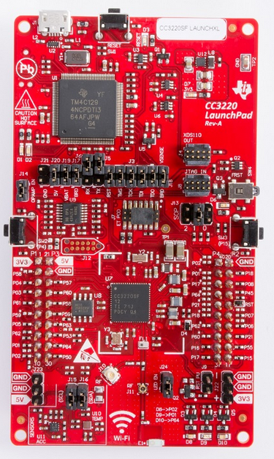
Texas Instruments CC3220SF
Wi-Fi Network Processor with static or dynamic IP address
IPv6 and TCP/IP capable
Automatic connection on startup
Ideal for IoT
Uses 5V at 0.5A supply voltage
1MB Flash, 256KB RAM
12 bit ADC
27 GPIO pins
All info from TI [6]

Slide 9
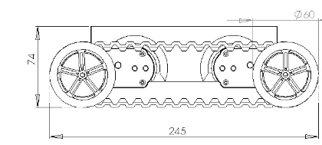
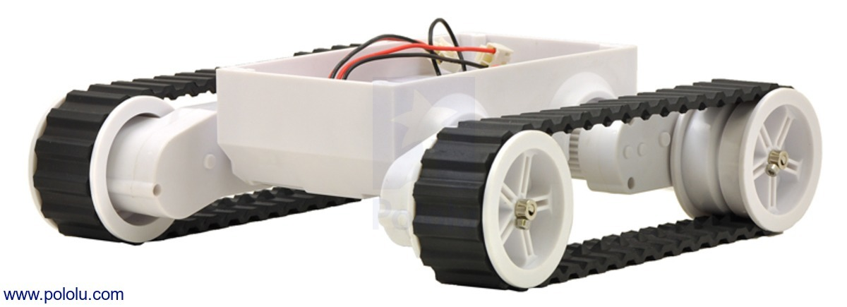
Rover Base
Dagu Rover 5
Motor Rated Voltage: 7.2V
Motor Stall Current: 2.5A
Motor Stall Torque: 10Kg/cm
Motors have 1000/3 encoders
Speed: 1Km/hr
All info from Pololu [5]

Slide 10
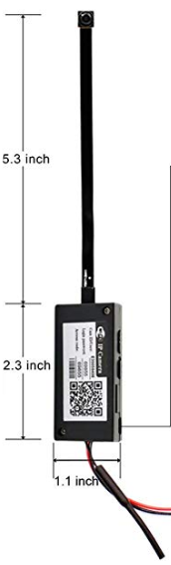
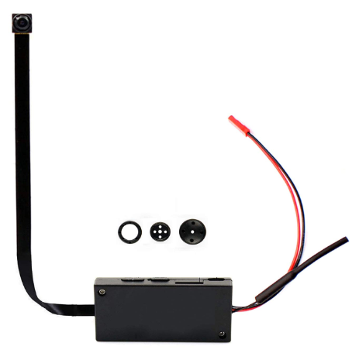
Camera - Magendara
IP Camera (WIFI)
$35.99
1280p, 25 fps
Rechargeable Battery
Can be used with app (for testing)
Connects to openCV using
camera’s IP address and P2P as input
Info and image from [1]

Slide 11
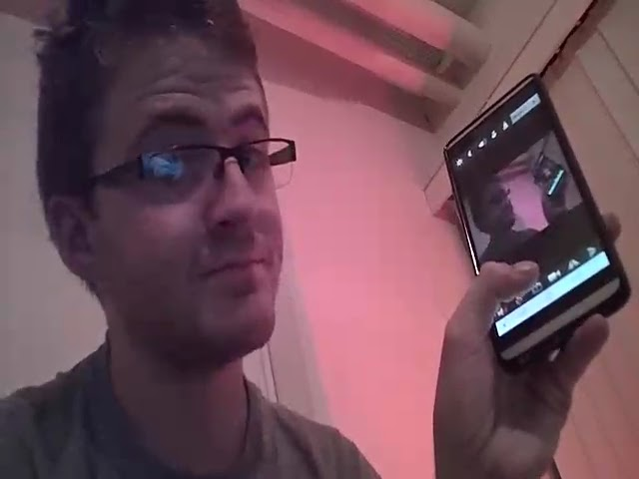
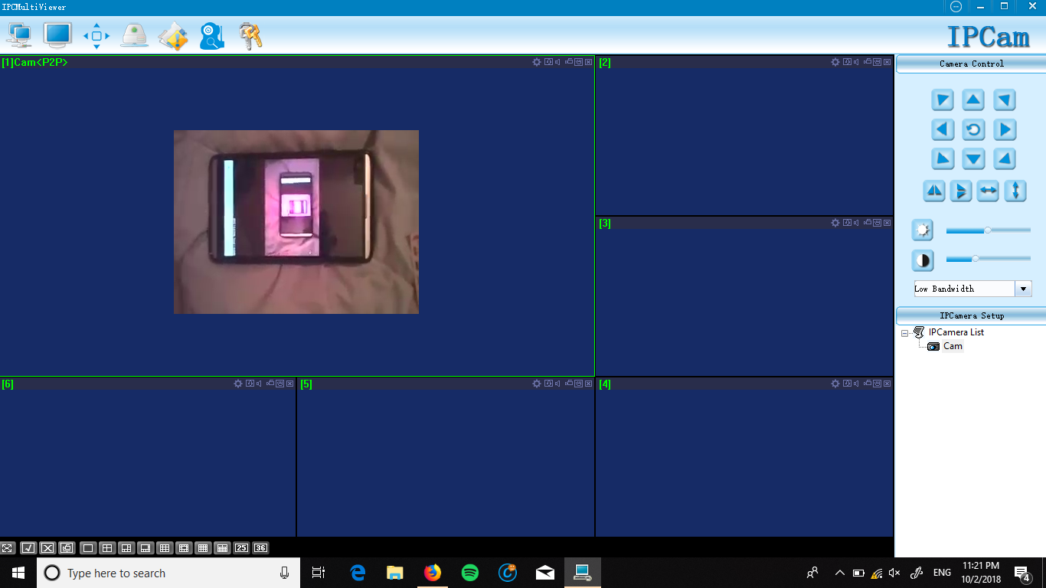
Testing the Camera
Picture taken Using the mobile app
Picture of the desktop application

Slide 12
Arm Servo
Servo motor - HS-422
Operating voltage 4.8 V - 6 V
8mA Idle current drain
.21sec/60 degrees
Electromagnet - uxcell 9V 50N Electric Lifting Magnet
Holding force 50N / 11.2 pound force
Joe Mahoney

Slide 13
Wifi Communication
CC3220 device
Baud 115200
Throughput 16Mbps
SimpleLink wifi allows for serial communication between devices connected on the same network.
Joe Mahoney

Slide 14
Arm Servo
Picking up flags Process
Once rover is in position the electromagnet will activate attracting the metal flag pole.
Once the flag is secure the servo will rotate a lever arm containing the electromagnet and flag. When the flag is over the bucket/ basket located on the servo side of the rover the magnet will power down releasing the flag.
The servo will then reset itself to its starting position.
Joe Mahoney

Slide 15
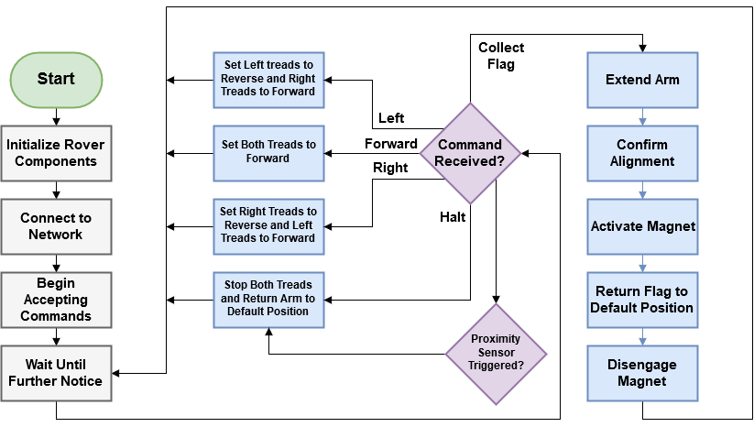
Rover Software Diagram

Slide 16
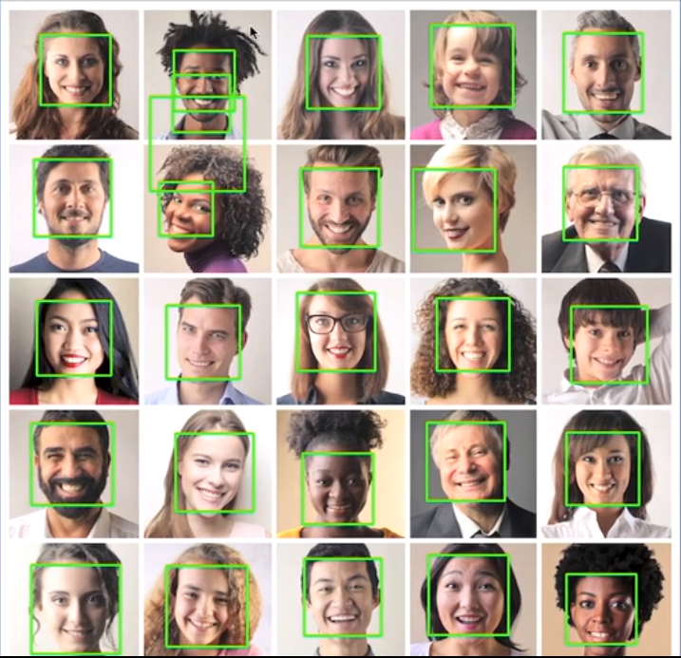
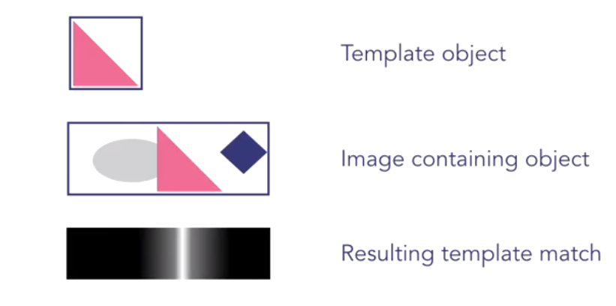
Computer Vision
Project description requires rover to use camera to view surroundings
OpenCV has video analyzing features allowing us to scan the rovers surroundings for the flags it is looking for
Different kinds of filters
Usually coded in python
[2]
[2]

Slide 17
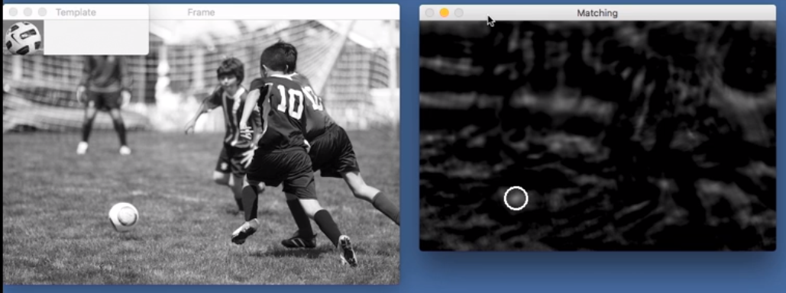
Template Matching
[2]

Slide 18
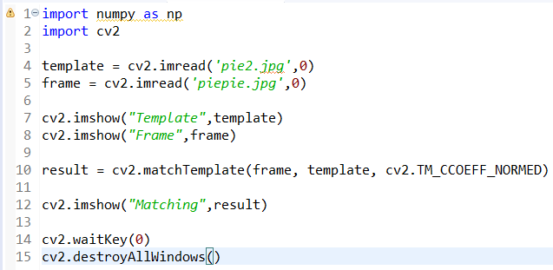
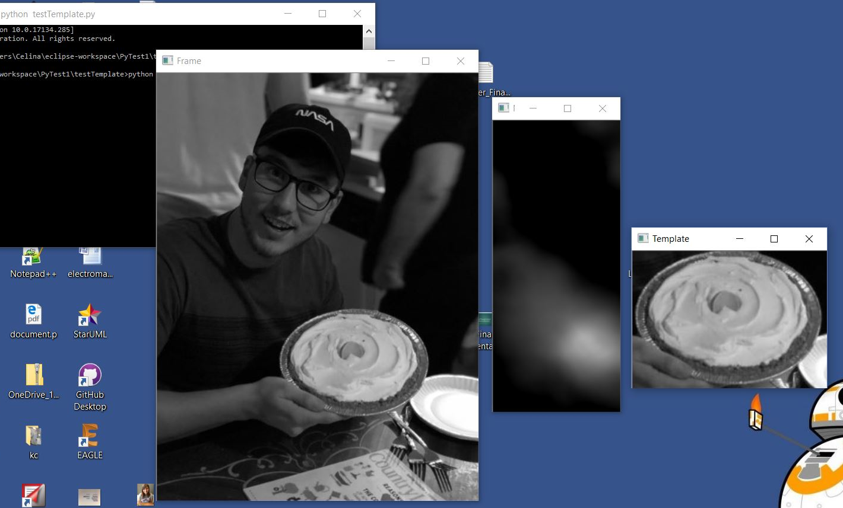

Slide 19
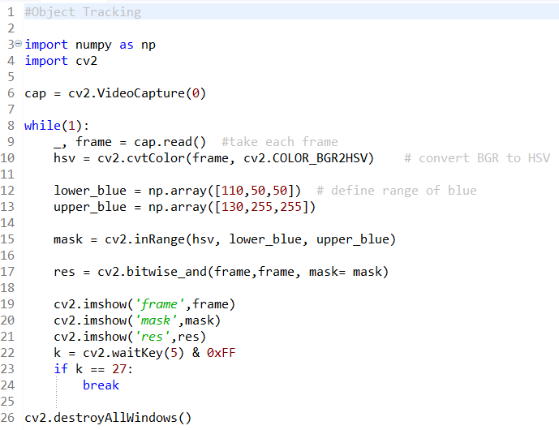
Object Tracking
www.openCV.org
Different sorts of filters/tracking
Color filters
Shape filters
Iterative location
MeanShift
CAMShift

Slide 20
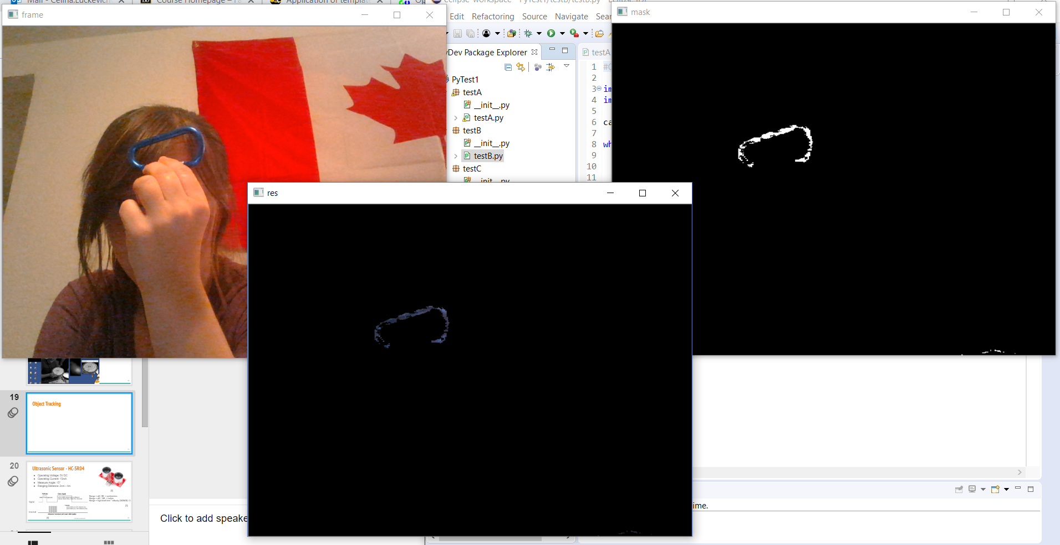

Slide 21
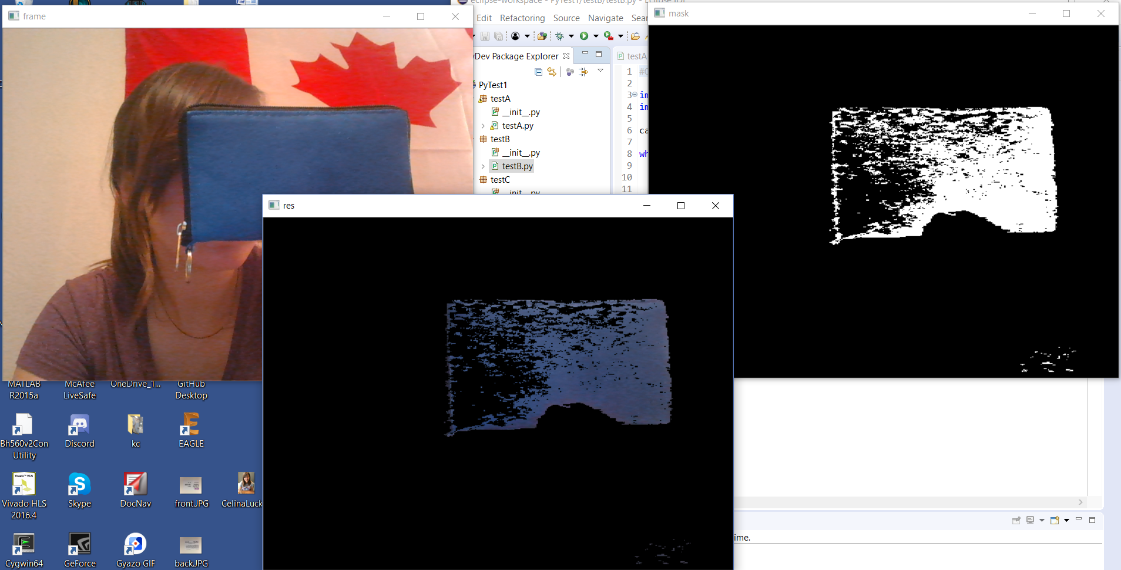

Slide 22
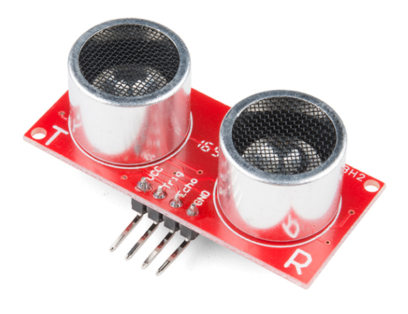
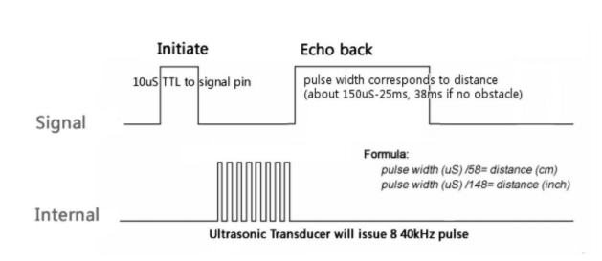
Ultrasonic Sensor - HC-SR04
Operating Voltage: 5V DC
Operating Current: 15mA
Measure Angle: 15°
Ranging Distance: 2cm - 4m
[3]
Range = uS / 58 -> centimeters
Range = uS / 148 -> inches
Range = high level time * velocity (340M/S) / 2
[3]
[4]

Slide 23
GUI - Python
Python GUI maker: tkinter (built-in)
Must use Python Image Library (PIL) for video feed
PIL contains tools for drawing text, windows, shapes, etc.
OpenCV stores images in BGR order; PIL needs RGB

Slide 24
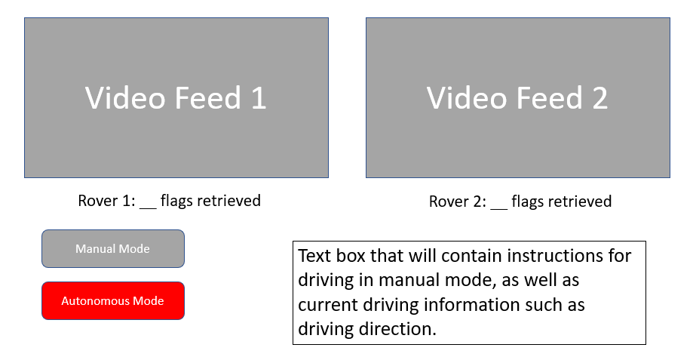
GUI Design

Slide 25
Advanced Rover Capabilities
Rovers know total number of flags in advance
Cooperative Mode: Rovers work together to find all flags
Competitive Mode: Rovers compete with the first to find a majority of flags declared winner
Rovers default to autonomous mode
Manual mode will be implemented entirely in the GUI

Slide 26
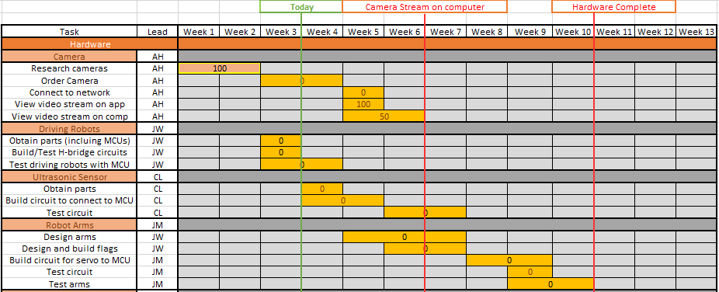
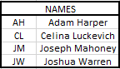
Gantt Chart - Hardware

Slide 27
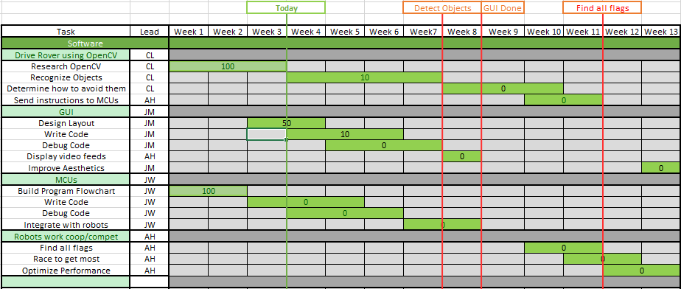
Gantt Chart - Software

Slide 28
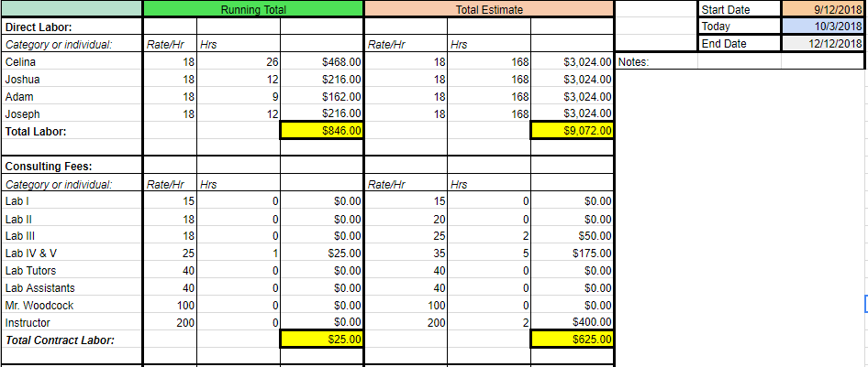
Budget

Slide 29
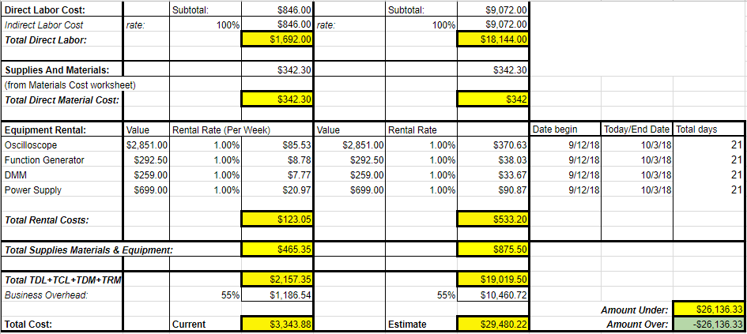
Budget

Slide 30
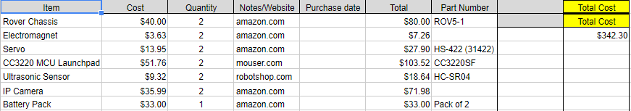
Budget - Materials

Slide 31
Next Week Deliverables
Josh
Continue learning OpenCV
Integrate the WiFi camera with OpenCV
Celina
Continue learning Python
Track a specified object/target in a video feed
Adam
Develop method for GUI and main code to interact
Complete camera to computer communication
Joe
Communicating with CC3220 Over wifi
GUI design fully researched/
sending commands via GUI researched
Basic rover movement code

Slide 32
References
Amazon.com. (2018) MAGENDARA Mini WiFi Camera [online] Available at: https://www.amazon.com/dp/B0762MB2TD/ref=cm_sw_r_other_apa_Cf9QBbMNS8AYN
Crawford, P. (2017). Introduction to template matching. [online] Lynda.com - from LinkedIn. Available at: https://www.lynda.com/Python-tutorials/Introduction-template-matching/601786/660495-4.html [Accessed 21 Sep. 2018].
Sparkfun.com. (2018). Ultrasonic Sensor - HC-SR04 - SEN-13959 - SparkFun Electronics. [online] Available at: https://www.sparkfun.com/products/13959 [Accessed 23 Sep. 2018].
ITead Studio. (2018). Ultrasonic ranging module : HC-SR04 data sheet. [online] Available at: https://www.electroschematics.com/wp-content/uploads/2013/07/HC-SR04-datasheet-version-2.pdf [Accessed 24 Sep. 2018].
Pololu.com. (2018). Dagu Rover 5 Tracked Chassis with Encoders. [online] Available at: https://www.pololu.com/product/1551/resources [Accessed 24 Sep. 2018].
TI.com. (2018). SimpleLink™ Wi-Fi® CC3220SF Wireless Microcontroller. [online] Available at: http://www.ti.com/lit/ds/swas035a/swas035a.pdf [Accessed 24 Sep. 2018].
Docs.opencv.org. (2018). OpenCV: Changing Colorspaces. [online] Available at: https://docs.opencv.org/3.1.0/df/d9d/tutorial_py_colorspaces.html [Accessed 1 Oct. 2018].

Slide 33
Questions?

